Slide 1
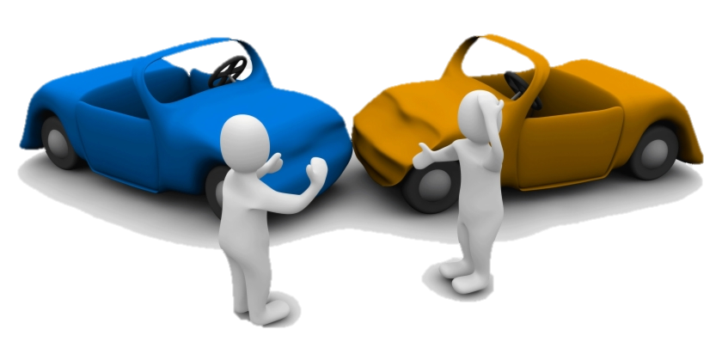

SAFE ROAD
An initiative to prevent the road accidents.
NAME | STREAM | YEAR
Sayantan Ghosh | CSE | 2nd Year
Anik Pal | CSE | 2nd Year
Diptarka Saha | ECE | 1st Year
Sunhik Pramanik | CSE | 2nd Year

Slide 2
CONTENT
INTRODUCTION-PROBLEM DESCRIPTION
  causes of accident
APPROACH BY OTHER PEOPLE
WHAT ARE WE DOING?(OUR OBJECTIVE)
HOW IS IT GOING TO WORK ?(TOOLS/SOFTWARES USED)
  hardware modules. (technical approach to the solution)
  block diagram (experimental setup)
  software application.
CONCLUSION (result and analysis)
WHAT FEATURES ARE WE PLANNING TO ADD IN FUTURE ? (FUTURE PLAN AND MODIFICATIONS)

Slide 3
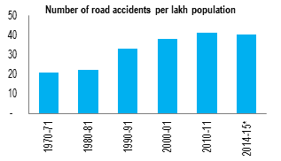
INTRODUCTION
In India, more than 150,000 people are killed each year in traffic accidents. That's about 400 fatalities a day and far higher than developed auto markets like the US, which in 2016 logged about 40,000.
In 2015, there were about five lakh road accidents in India, which killed about 1.5 lakh people and injured about five lakh people.

Slide 4
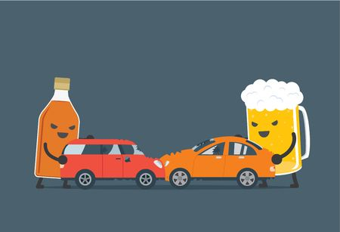
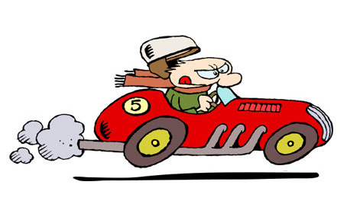
CAUSES OF ACCIDENTS
The major reason for these accidents being:
Over Speeding
Driving under influence of alcohol
Distraction to Driver
Red Light jumping
Avoiding Safety Gears like seat belts and helmets

Slide 5
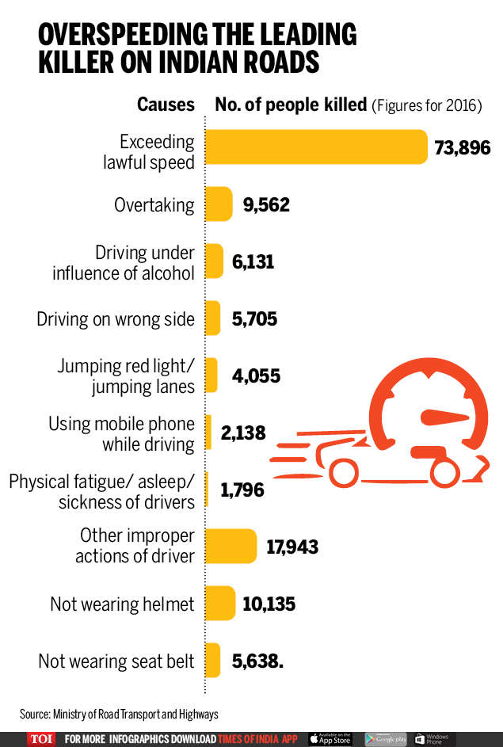
GRAPH SHOWING US THE FREQUENCY OF DIFFERENT CASUES OF ACCIDENTS

Slide 6
APPROACH BY OTHERS
Many people have made different modules regarding the accident detection in the past few years.
There are many videos on youtube.com and other platform regarding this modules.
The basic components of all these modules are the same as we have used.
But there is no software regarding this project.

Slide 7
WHY ARE WE DOING THIS PROJECT ?
The increase in the number of accidents day by day.
The accident site will be known easily.
Immediate assist from police and relatives will be available if anyone meets any sort of accident.
Phone will go into silent mode immediately once we enter the driver mode hence, it will help us stay focused in driving and not get distracted by phone calls.

Slide 8
HOW IS IT GOING TO WORK?
The project basically has two parts, the hardware module part and the software part.
The hardware module will be attached with the vehicle itself and the software application will be present in the mobile phones.
The software application will be present in the mobile device and will be functioning independently while giving you the same benefits as that of the hardware.

Slide 9
HARDWARE MODULES
HERE ARE THE DIFFERENT HARDWARES WE ARE GOING TO USE IN OUR PROJECT

Slide 10
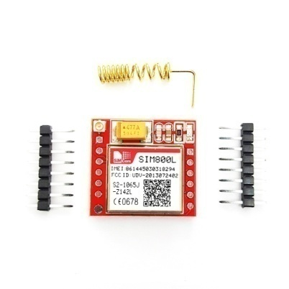
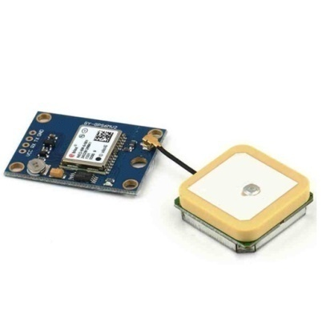
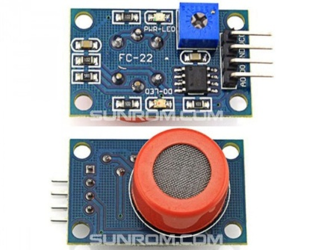
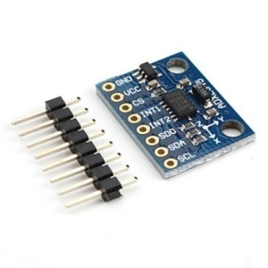
The Hardware part will mainly consist of:
Arduino UNO Rev3
ADXL345 Digital Accelerometer
SIM800L GSM Module
NEO-6S GPS Module
MQ3 Gas Sensor
SIM800L GSM MODULE
NEO-6S GPS MODULE
MQ3 GAS SENSOR
ADXL345 DIGITAL ACCELEROMETER

Slide 11
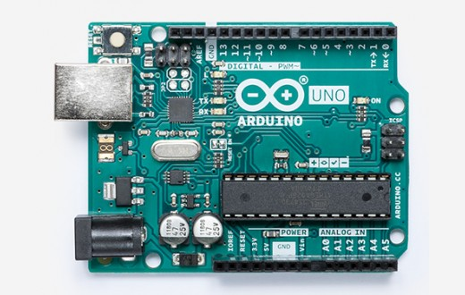
Arduino UNO Rev3
Arduino Uno is a microcontroller board based on the ATmega328P. It has 14 digital input/output pins (of which 6 can be used as PWM outputs), 6 analog inputs, a 16 MHz quartz crystal, a USB connection, a power jack, an ICSP header and a reset button. It contains everything needed to support the microcontroller; simply connect it to a computer with a USB cable or power it with a AC-to-DC adapter or battery to get started.. You can tinker with your UNO without worring too much about doing something wrong, worst case scenario you can replace the chip for a few dollars and start over again.

Slide 12
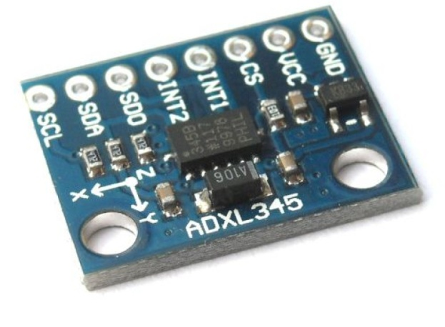
ADXL345 Digital Accelerometer
The ADXL345 is a low-power, 3-axis MEMS accelerometer modules with both I2C and SPI interfaces. The Adafruit Breakout boards for these modules feature on-board 3.3v voltage regulation and level shifting which makes them simple to interface with 5v microcontrollers such as the Arduino.
The sensor consists of a micro-machined structure on a silicon wafer. The structure is suspended by polysilicon springs which allow it to deflect smoothly in any direction when subject to acceleration in the X, Y and/or Z axis. Deflection causes a change in capacitance between fixed plates and plates attached to the suspended structure. This change in capacitance on each axis is converted to an output voltage proportional to the acceleration on that axis.

Slide 13
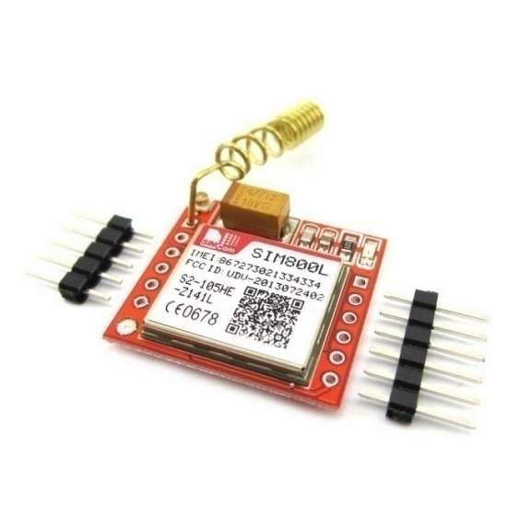
SIM800L GSM Module
SIM800L is a miniature cellular module which allows for GPRS transmission, sending and receiving SMS and making and receiving voice calls. Low cost and small footprint and quad band frequency support make this module perfect solution for any project that require long range connectivity. After connecting power module boots up, searches for cellular network and login automatically. On board LED displays connection state (no network coverage - fast blinking, logged in - slow blinking).

Slide 14
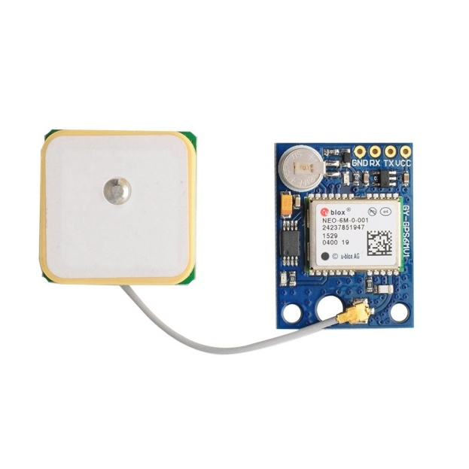
NEO-6S GPS MODULE
The NEO-6 module series is a family of stand-alone GPS receivers featuring the high performance u-blox 6 positioning engine. These flexible and cost effective receivers offer numerous connectivity options in a miniature 16 x 12.2 x 2.4 mm package. Their compact architecture and power and memory options make NEO-6 modules ideal for battery operated mobile devices with very strict cost and space constraints.

Slide 15
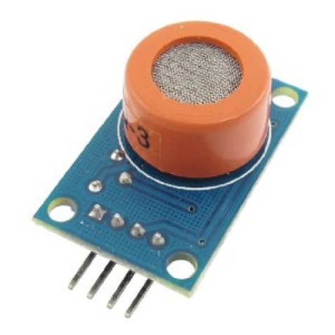
MQ3 Gas Sensor
This module is made using Alcohol Gas Sensor MQ3. It is a low cost semiconductor sensor which can detect the presence of alcohol gases at concentrations from 0.05 mg/L to 10 mg/L. The sensitive material used for this sensor is SnO2, whose conductivity is lower in clean air. It’s conductivity increases as the concentration of alcohol gases increases.
It has high sensitivity to alcohol and has a good resistance to disturbances due to smoke, vapor and gasoline. This module provides both digital and analog outputs. MQ3 alcohol sensor module can be easily interfaced with Microcontrollers, Arduino Boards, Raspberry Pi etc.
This alcohol sensor is suitable for detecting alcohol concentration on your breath, just like your common breathalyzer. It has a high sensitivity and fast response time. Sensor provides an analog resistive output based on alcohol concentration. The drive circuit is very simple, all it needs is one resistor. A simple interface could be a 0-3.3V ADC.

Slide 16
WORKING
HERE WE ARE GOING TO SEE HOW THESE MODULES ARE WORKING TOGETHER.

Slide 17
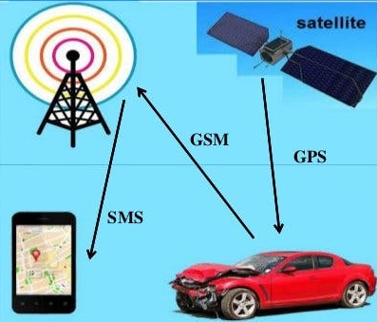
THE BASIC WORKING OF THE HARDWARE MODULES

Slide 18
WORKING OF THE SYSTEM
The ADXL 345 accelerometer is responsible for giving us the value of the acceleration of the vehicle. During collision a certain value is generated from the accelerometer which will be recorded by the ARDUINO UNO and distinguished as a collision by it depending on the value.
The accelerometer is also responsible for keeping the car in the normal stipulated speed by continuosly judging the speed of the vehicle and if the driver starts over speeding the module will feed the data to arduino who will in turn start sending alert messages to the driver , with the help of SIM800L GSM MODULE.

Slide 19
WORKING OF THE SYSTEM
After collision the NEO-6S GPS MODULE feeds the Arduino with the location of the accident site.
After the coordinates of the accident site has been confirmed the SIM800L GSM MODULE sends the coordinate of the site to the relative of the driver and to a nearby police station.
The MQ3 GAS SENSOR is used to sense whether the driver is drunk or not. The gas sensor will produce different value depending on the intensity of the smell produced. As soon as the Arduino understands that the driver is drunk above the legal limit the Arduino prevents the driver from driving by locking the system.

Slide 20
SATELITE
ADXL345 ACCELEROMETER
SENDING VALUES
SENDING COORDINATES
ARDUINO UNO REV3
NEO-6S GPS MODULE
SIM800L GSM MODULE
SENDING TEXTS TO PHONE
SENDING VALUES
MOBILE DEVICES
MQ3 GAS SENSOR
BLOCK DIAGRAM
BLOCK REPRESENTATION OF HOW THE MODULES WORK TOGETHER.

Slide 21
SOFTWARE APPLICATION
HERE WE WILL DISCUSS ABOUT THE APP WHICH WILL BE INSTALLED IN OUR MOBILE DEVICES.

Slide 22
HOW IS THE APP WORKING?
The software will cover almost the same thing as the hardware is doing, the difference being that the software will be present in the mobile device and working independently, thus making it useful in case the hardware fails.

Slide 23
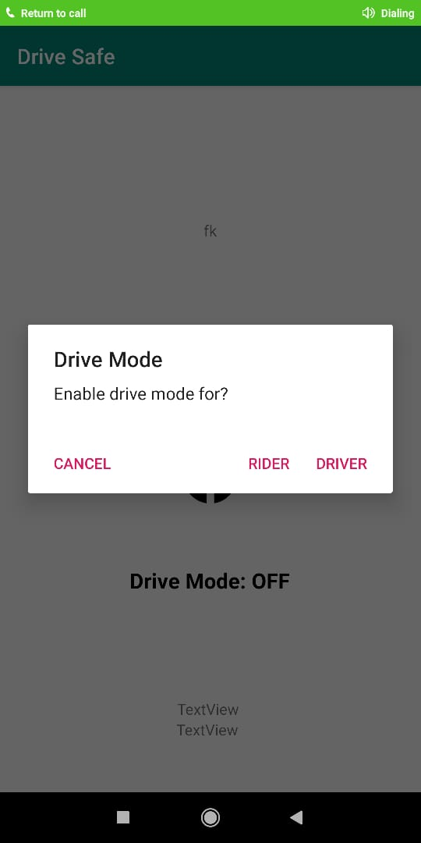
The application gives you two options of signing in i.e. either as a driver or a rider.
While in Driver mode, your phone will go into silent mode by itself. Other than this the app will work similarly in both the modes.

Slide 24
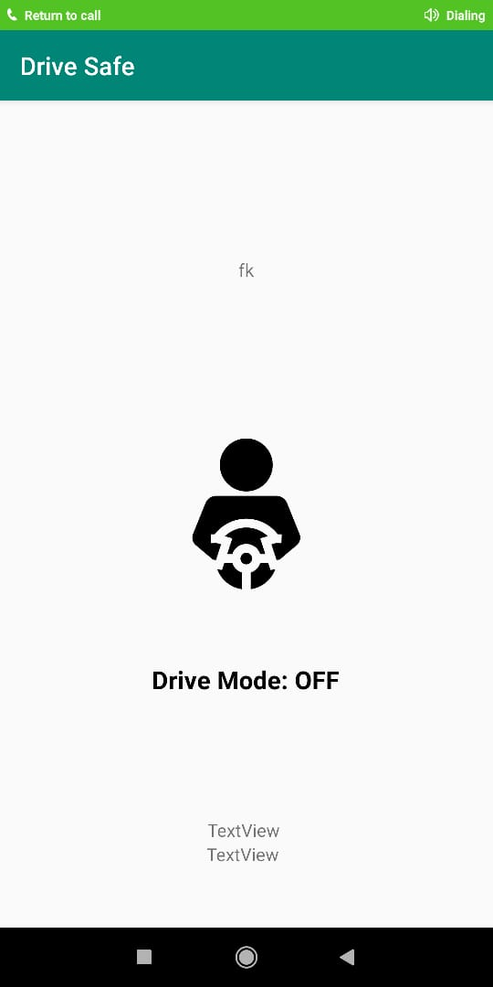
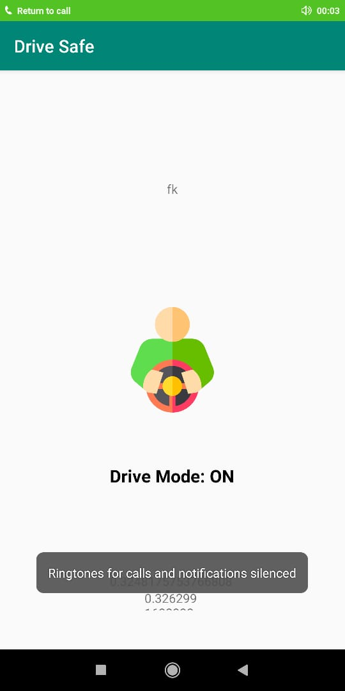
Once we enter the driver mode we see there is a change in the color of the picture on screen, thus telling us that we have entered DRIVER MODE.

Slide 25
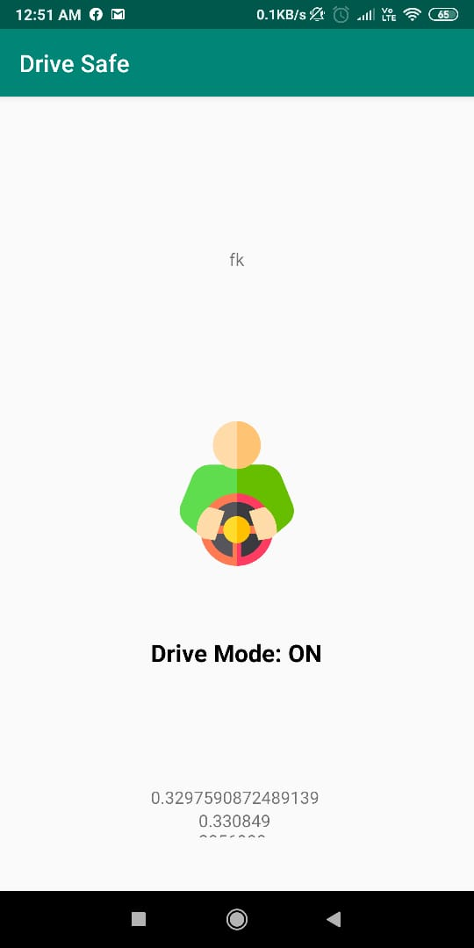
As soon we enter any mode we see that the app starts calculating the acceleration and other important values.

Slide 26
BENEFITS
The location of accident can be easily tracked down.
Medical helps can arrive quickly in the accident sites.
People who will be drunk won’t be able to drive the vehicles.
The driver mode feature of the app will make the phone silent which will ensure that we don’t get distracted by incoming call or texts.
Making both the hardware and software independent, we ensure that if one system fails then we can easily work with the other system.
In case the driver is drunk his/her family will be notified and they can take the necessary steps.

Slide 27
DISADVANTAGES
Internet service is not uniform in all the places. Hence the GPS module may not be able to provide the location for all the places.
Many of the modules are very sensitive and can give different values with a slight change in altitude, smell, etc.
Our system is doing nothing to control the top speed i.e. A driver can over speed even after getting the alert messages. In this case we are not able to control the speed of the vehicle.

Slide 28
CONCLUSION
We hope that this project will,
slowly reduce the number of deaths caused by road accidents,
Help the police and the ambulance reach the accident site quickly,
Make the drivers conscious of the basic rules he/she follow while driving in order to avoid any accident,
And lastly will, make the road safer for the peddlers and other people walking on the road.

Slide 29
QUESTIONS REGARDING THE PROJECT

Slide 30
WHAT FEATURES ARE WE PLANNING TO ADD IN FUTURE?
This module can be easily installed in the vehicles.
We can even try to make the messaging part more precise so that the message is sent to a nearby hospital and a police station instead of any random hospital or police station.
We can combine the program with the air bags of the vehicles in such a way that when the accelerometer will give us a certain value it will instantly open the air bag protecting the driver.

Slide 31
REFERENCES
Source for pictures: www.images.google.com
: www.flaticon.com
Others : International Journal of Innovative Research in Computer and Communication Engineering.
:Institute for Software Integrated Systems.

Slide 32
THANK YOU
A PROJECT BY: SAYANTAN GHOSH, ANIK PAL, DIPTARKA SAHA AND SUNHIK PRAMANIK.

